Slide 1
MHAA-USNR System
A dynamic website for Maggotty High Alumni Association - US Northern Region
December 14, 2020
By AntiVirus Team
Shada Khanneh Aseel Aloweiwi Mira Boulos Iman Almutairi Amal Alamri
Supervised By
Dr. Hubert A. Johnson

Slide 2
What is MHAA-USNR System?
“MHAA-USNR” System is a Dynamic Website designed to serve the Maggotty High Alumni Association - US Northern Region needs and requirements.
Purpose of the Project
Providing a user-friendly website that enables users to easily navigate through the website and learn about the history of the school, its mission and background.
Inform the website’s visitors on how the donations contribute to develop a better learning environment for the school’s students.
Facilitate the event registration process and fund donations.
Grant the association officers a simple way to create Events and add News using the website.

Slide 3
Unified look
Accessibility
Ease of navigation
Add and delete specified page content
Electronic Payment feature
System Requirements

Slide 4
Requirement Elicitation
General Requirements
Functional Requirements
Non-Functional Requirements

Slide 5

General Requirements
Language | System interface will support English language only.
Error Messages | Unified display method across the system. Indicate error cause.
Color Scheme | School colors: beige, burgundy and gold
Navigation | Navigation Bar List of links

Slide 6
View website pages and content | Ability to view the Homepage, History, Alumni News, Events, Officers and Donations
Register for Events | Enables users to register in the Upcoming-Events posted by the association’s officers.
Donate Funds | Enables users to to donate funds to the association
Login | For officers and administrator
Logout | For officers and administrator
Add News | For officers and administrator to add News
Delete News | For officers and administrator to delete News record from the Alumni News page
Add Events | For officers and administrator to add Previous and Upcoming-Events
Delete Events | For officers and administrator to delete Events record from the Events page
Change of content | For administrator to change specified page content
Functional Requirements

Slide 7
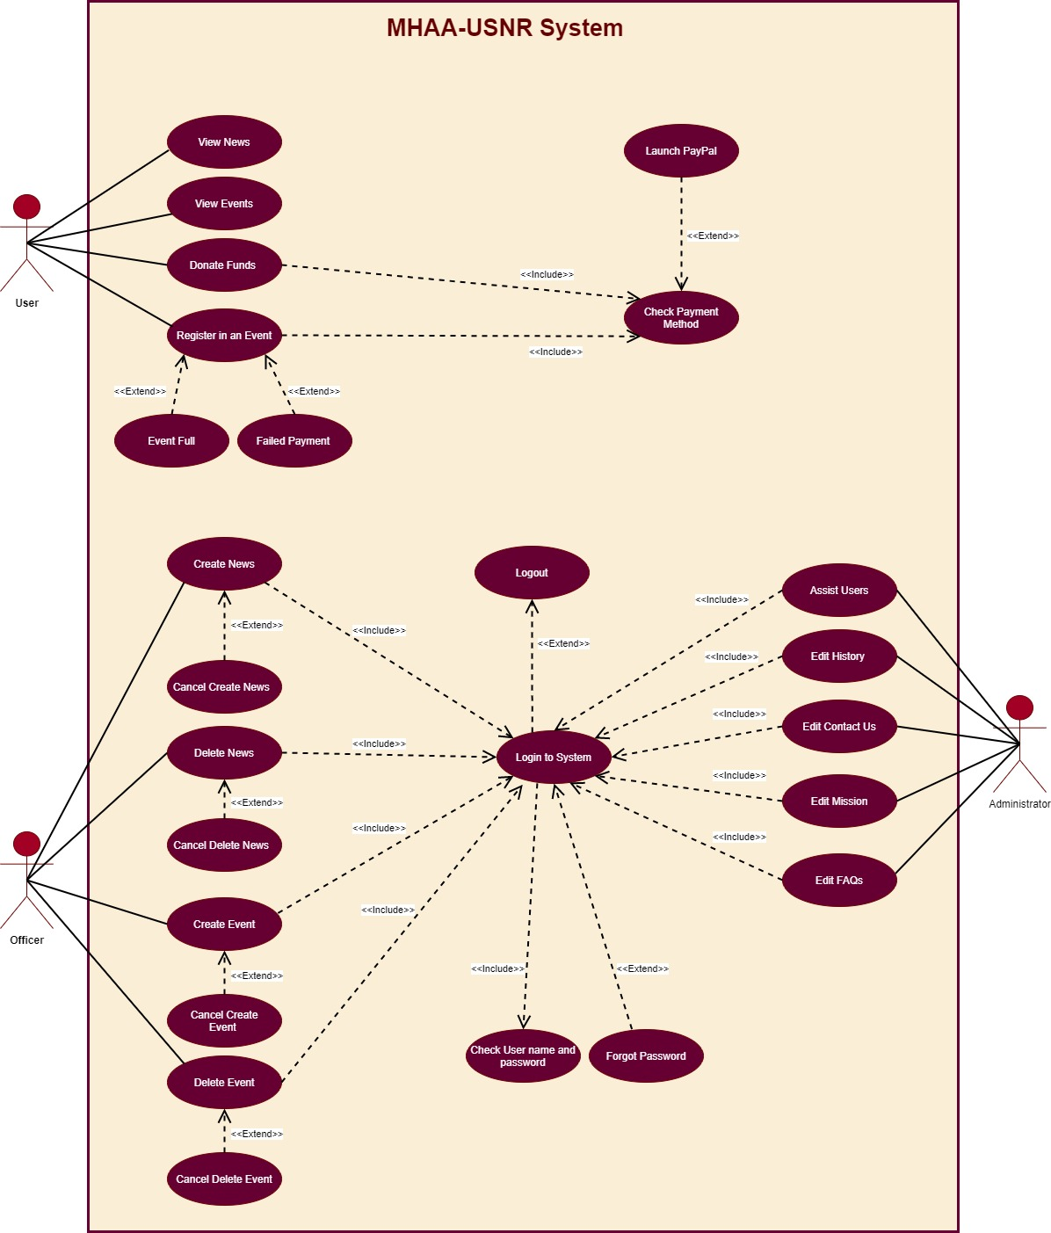
Use-Case Diagram

Slide 8
Compatibility | Supported on PCs (Personal Computers) and PMDs (Personal Mobile Devices) browsers Chrome and Safari Indicate error cause.
Reliability and Efficiency | Up 50 users simultaneously without any loss in performance speed 2 seconds to view the requested link 85% reliability for a duration of at least two years on PCs and PMDs.
Availability | For all users
Organizational Impact | Facilitate donation Increase donation income Improve and digitalize events registration Increase people awareness of the organization
Operation and Environment | Organization’s environment. Internet access and a database server
Security | Secure channels for payments Password encryption
Non-Functional Requirements

Slide 9
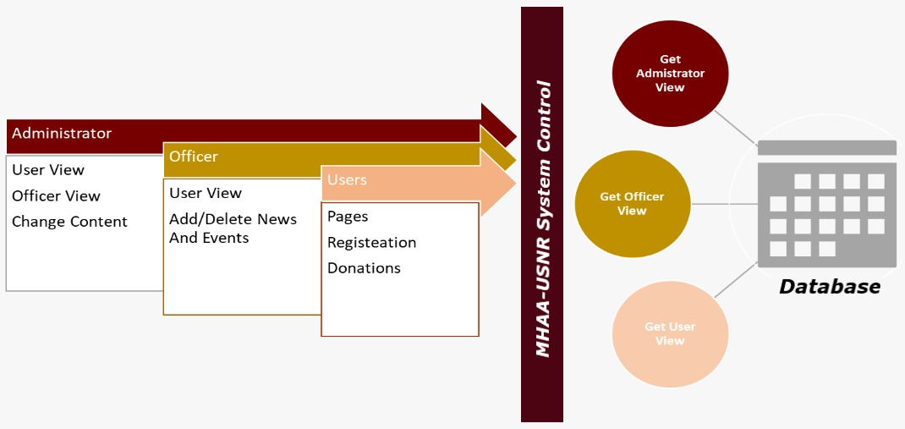
General Design Approach
Design

Slide 10
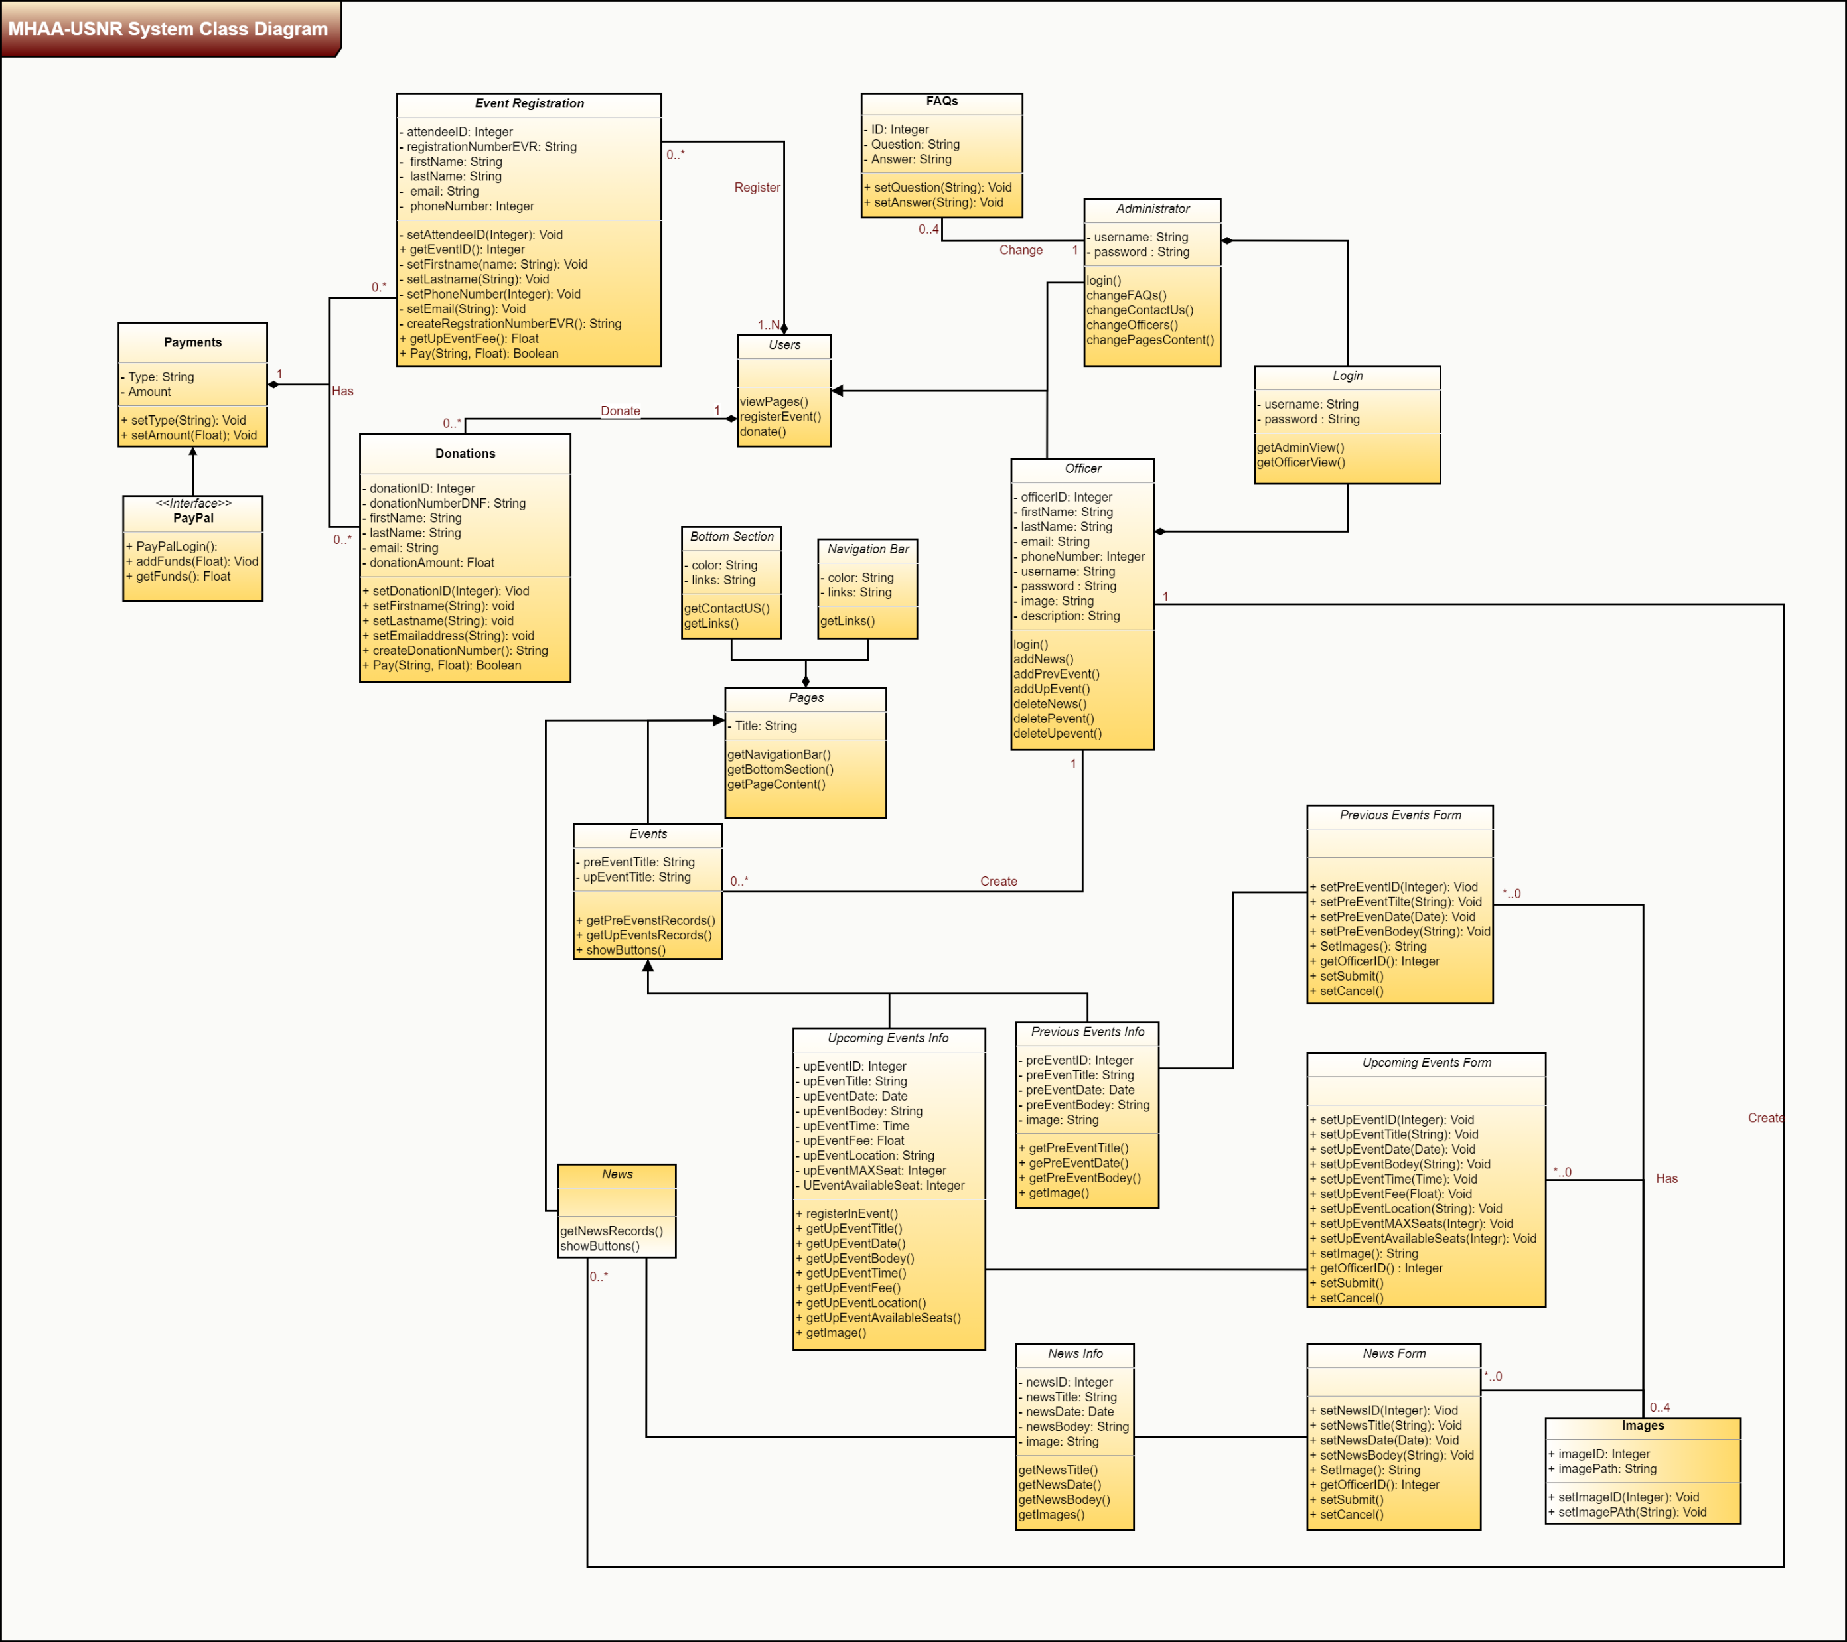
Class Diagram

Slide 11
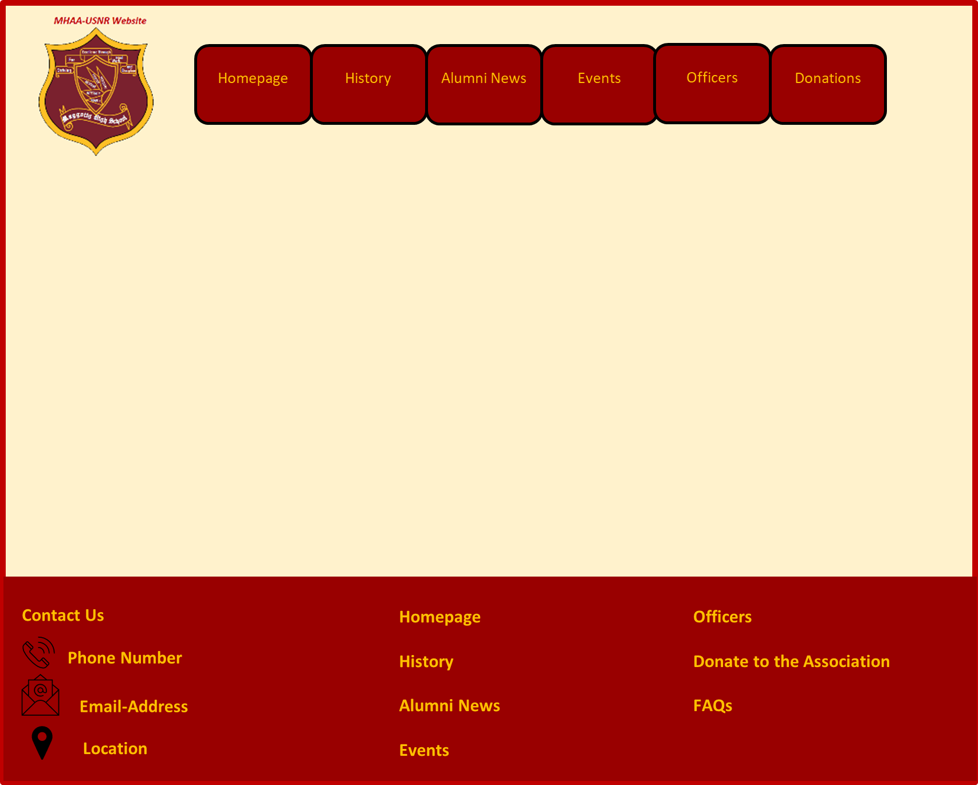
Unified Pages Look
This figure illustrates the unified look across system pages/screens.

Slide 12
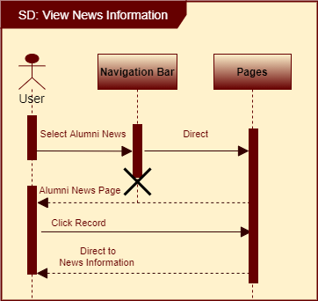
User-View
“Viewing Page Content” Sequence Diagram

Slide 13
For officers and administrator
Preset Username and Passwords for five officers
Preset Username and Password for one administrator
Login

Slide 14
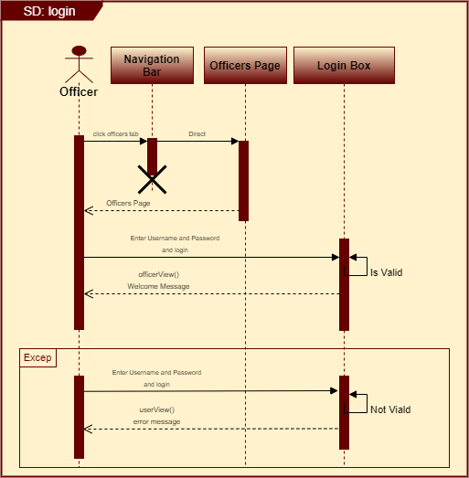
“Login” Sequence Diagram

Slide 15
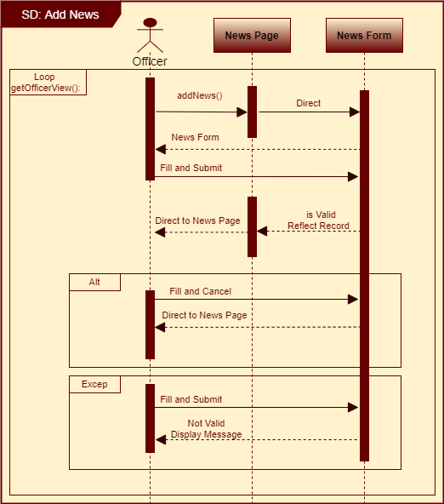
Officers-View
“Add News” Sequence Diagram

Slide 16
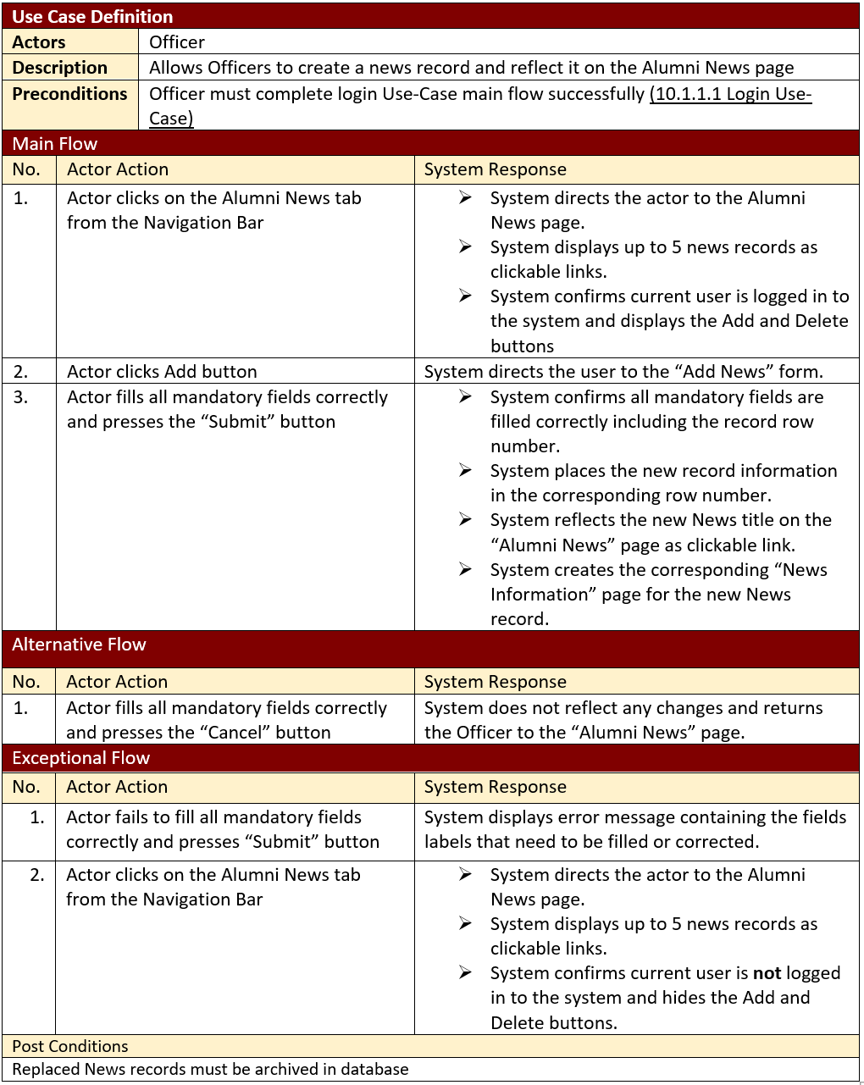
“Add News” Use-Case

Slide 17
Website Pages
Control
Data Base
Implementation

Slide 18
Implemented Modules
Static Pages
Navigation
Event Registration Process
Donation Process
Login/Logout
Add News Process
Delete News Process
Add Upcoming- Event Process
Delete Upcoming-Event Process
Add Previous-Event Process
Delete Previous-Event Process
Change Homepage
Change History
Change Contact Us
Change FAQs

Slide 19
Implementation Tools
Languages:
HTML Language
PHP
CSS
Software:
XAMPP 7.4.1
Editor
Komodo IDE 12

Slide 20
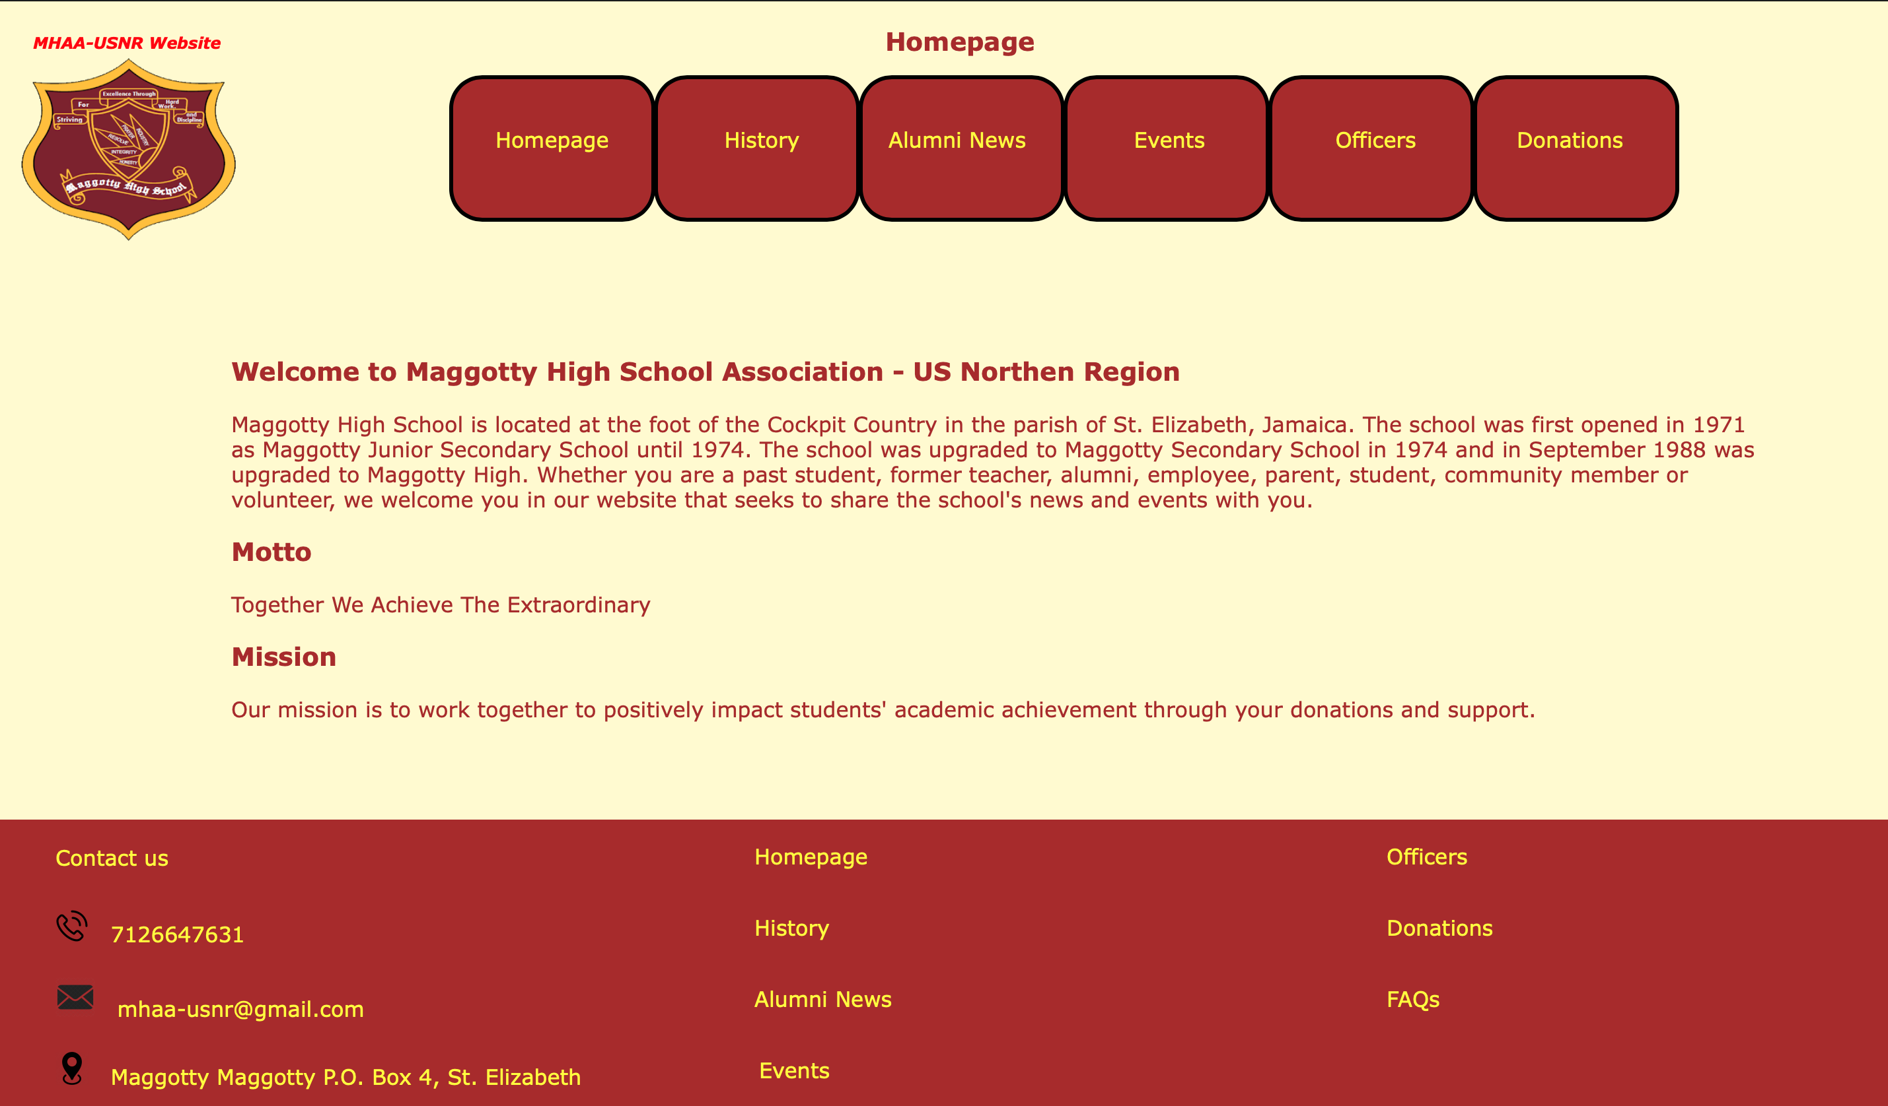
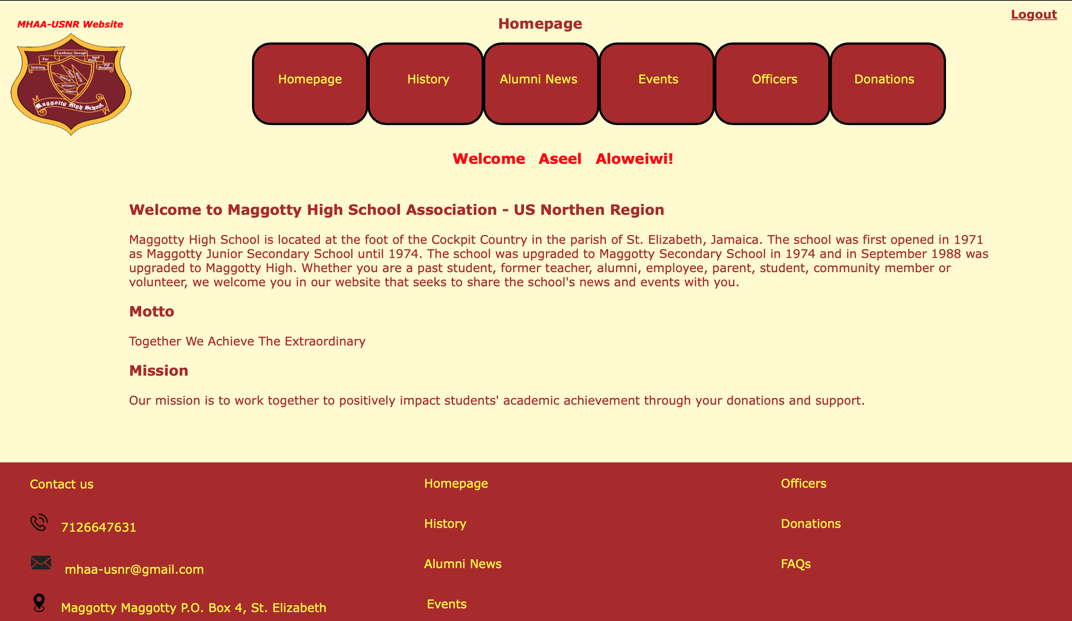
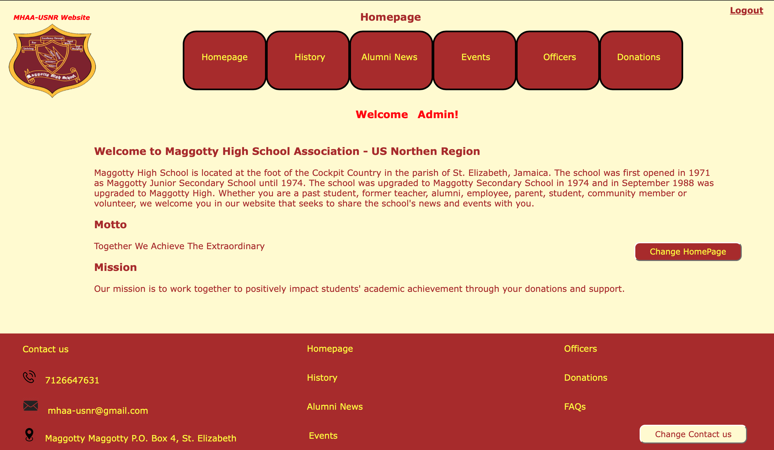
Homepage
Officer-view
Welcome message
Logout link
User-view
Ability to Navigate the system pages
Ability to View content
Administrator-view
Welcome message
Change content button
Logout link

Slide 21
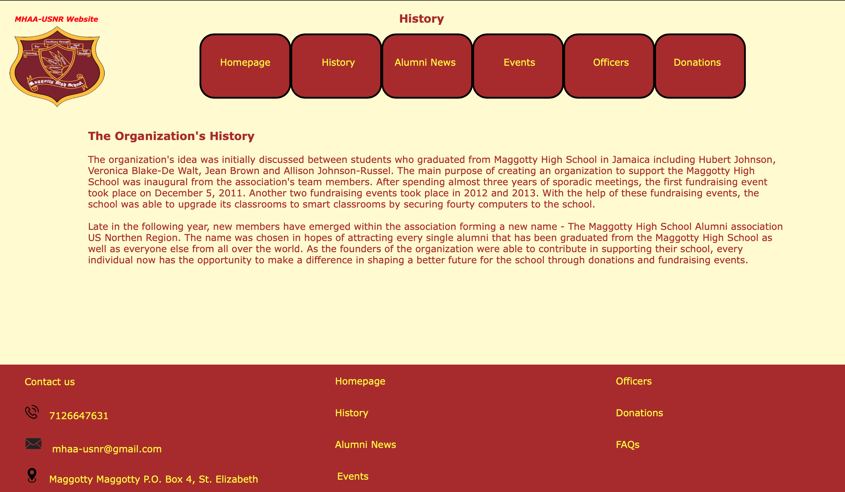
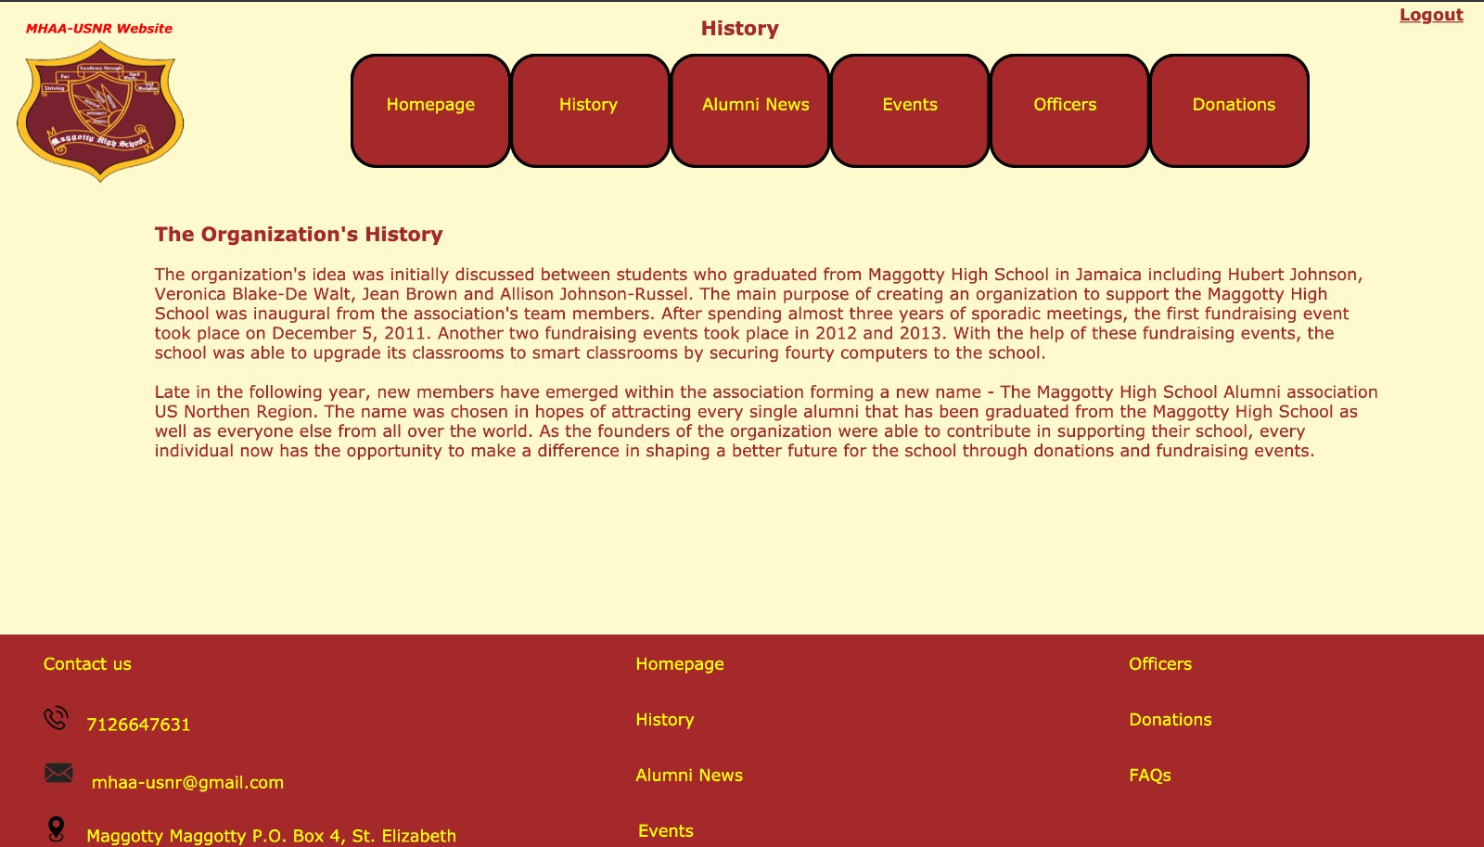
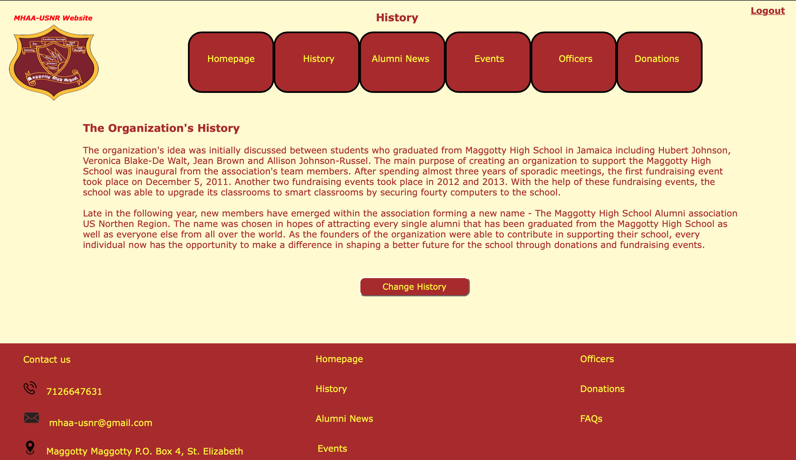
History
Officer-view
Logout link
User-view
Ability to Navigate the system pages
Ability to View content
Administrator-view
Change content button
Logout link

Slide 22
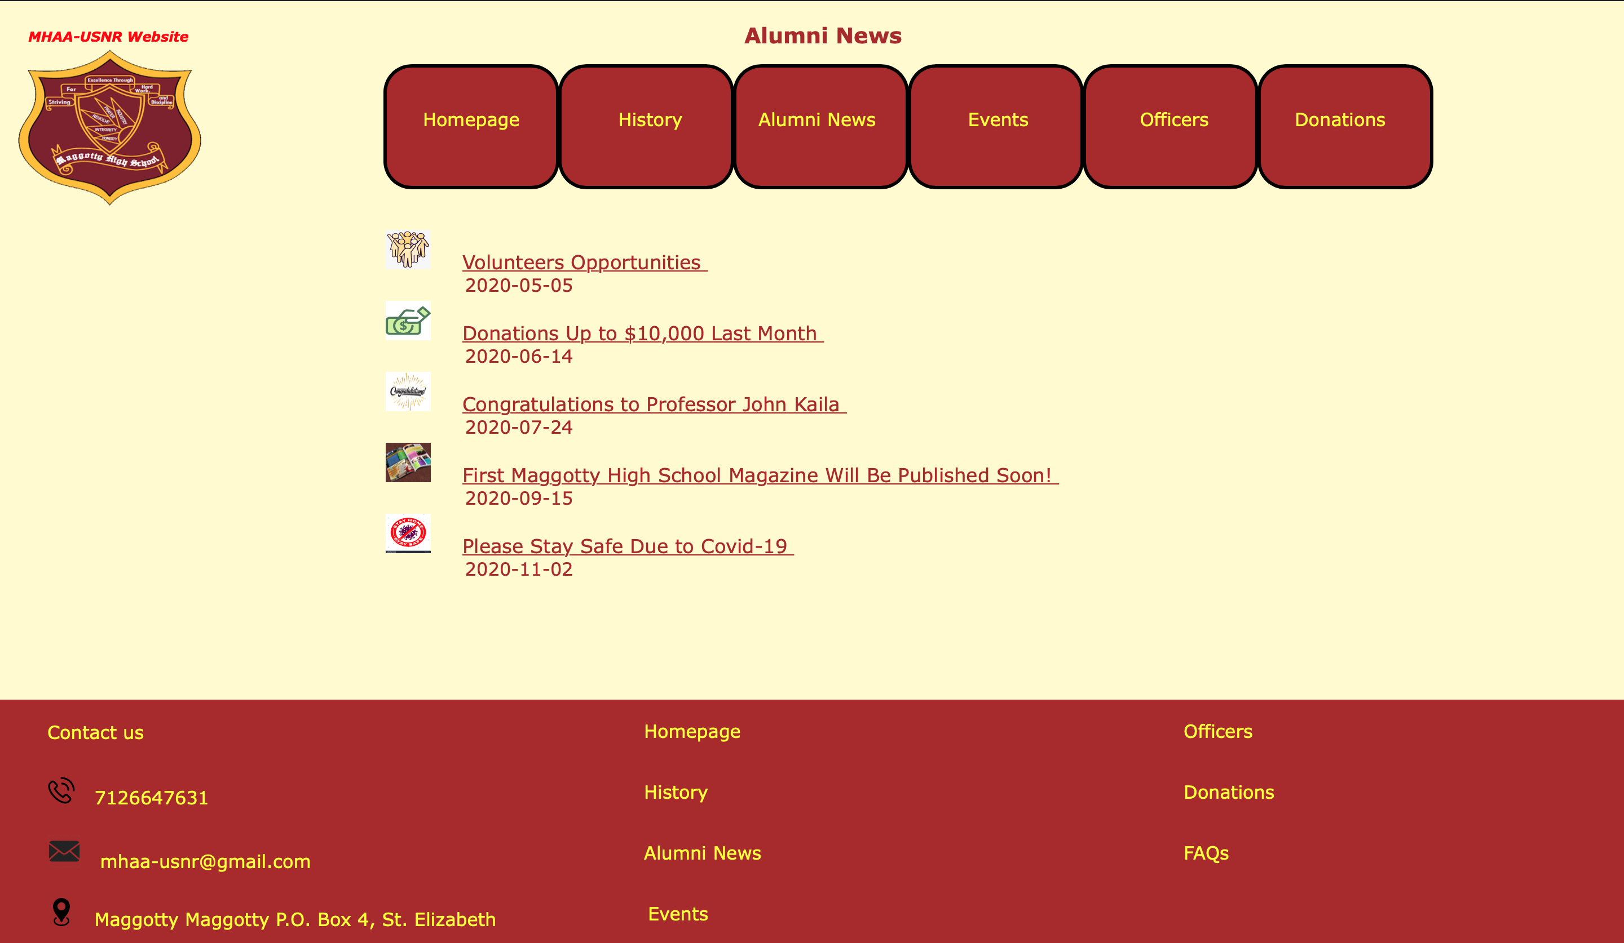
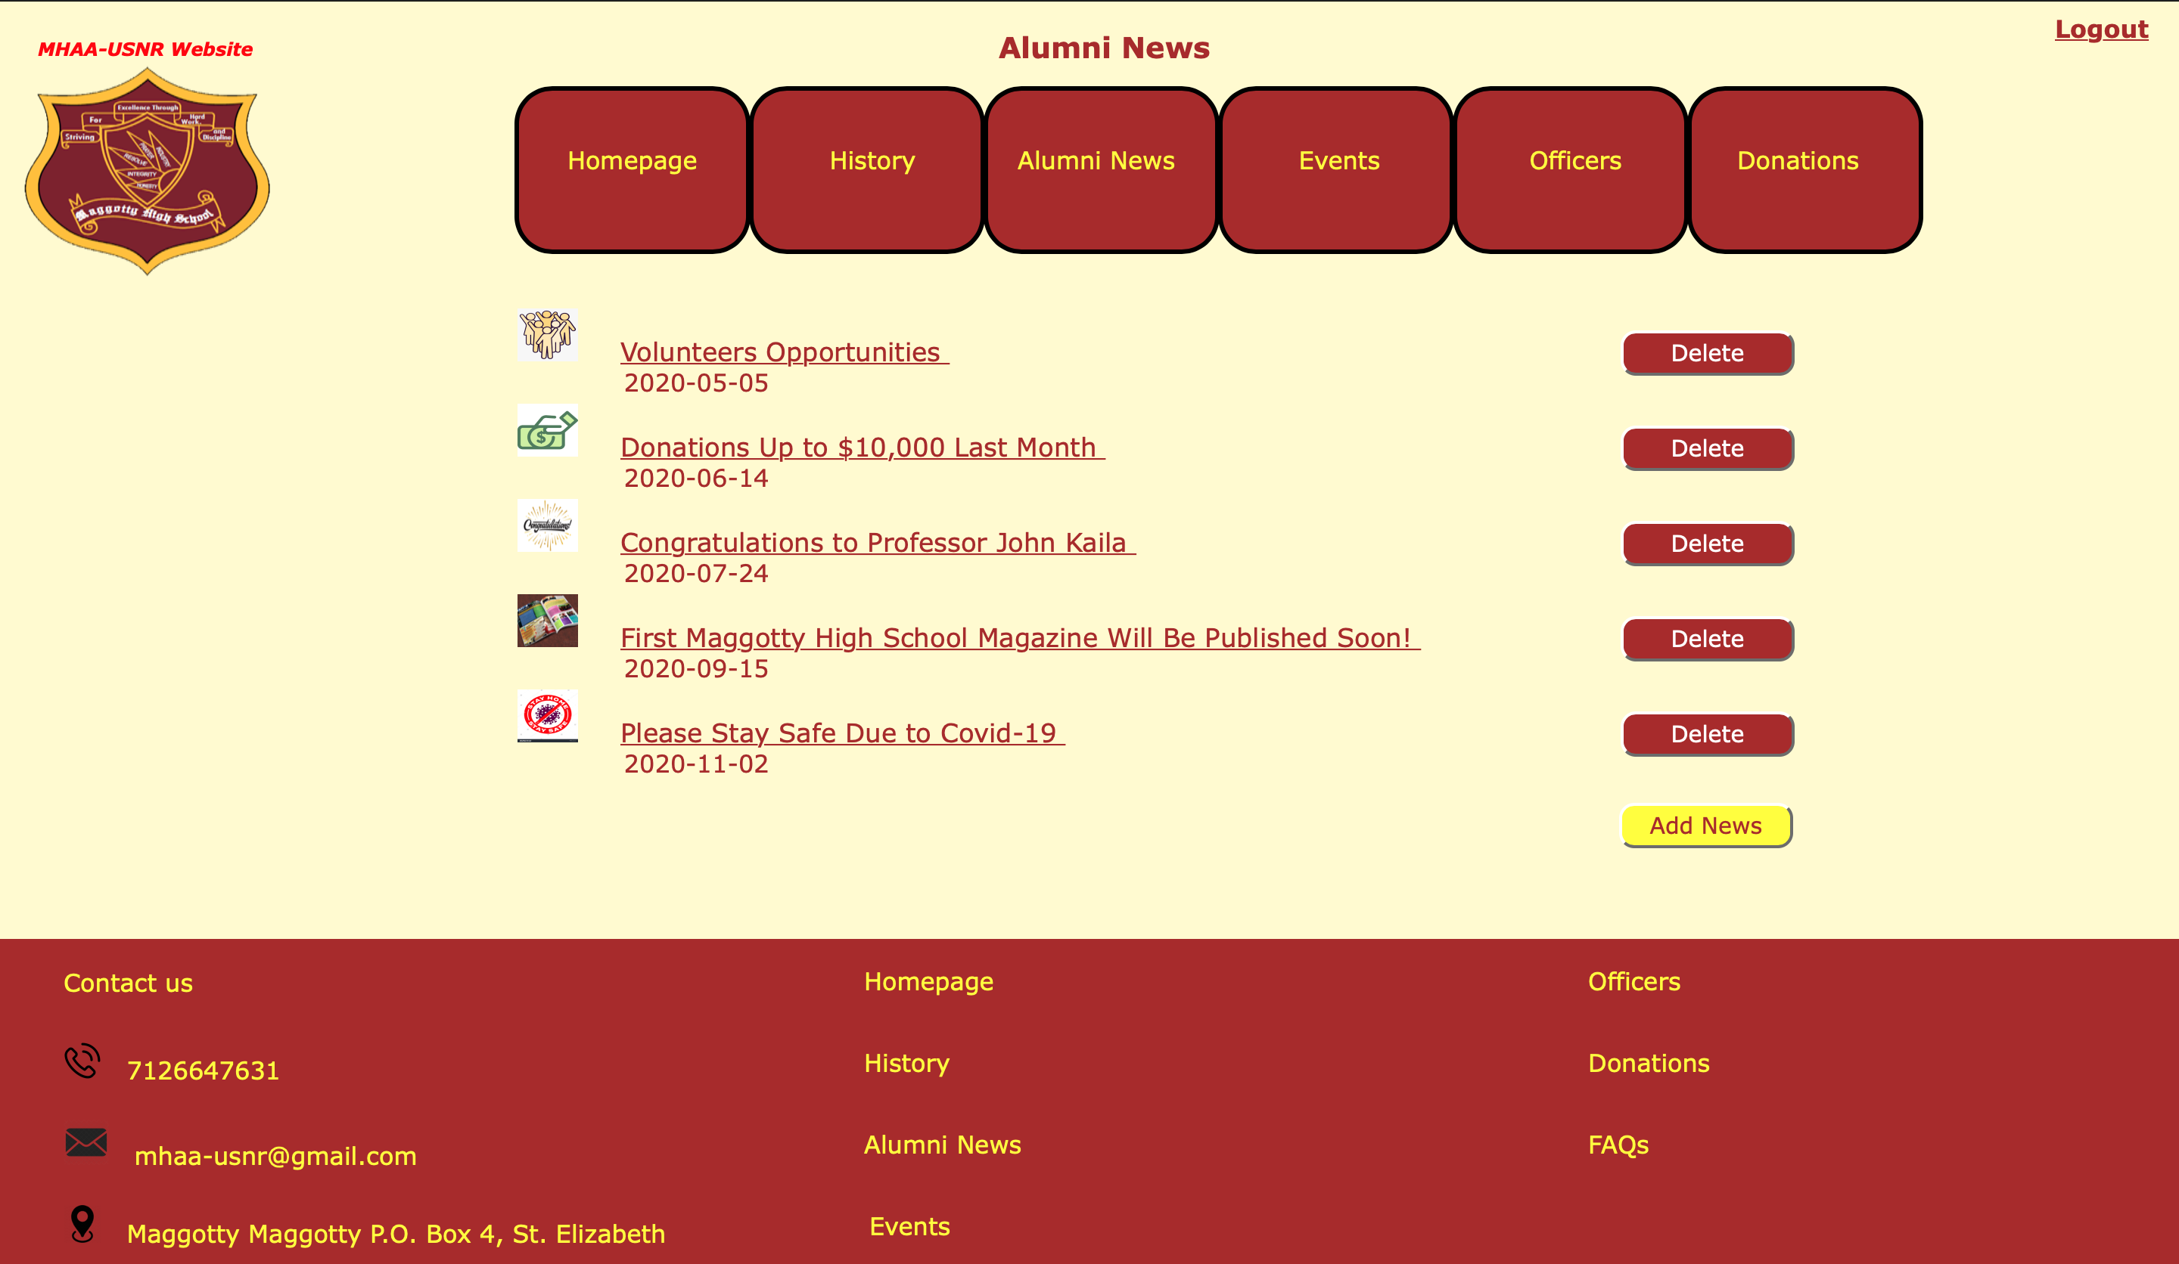
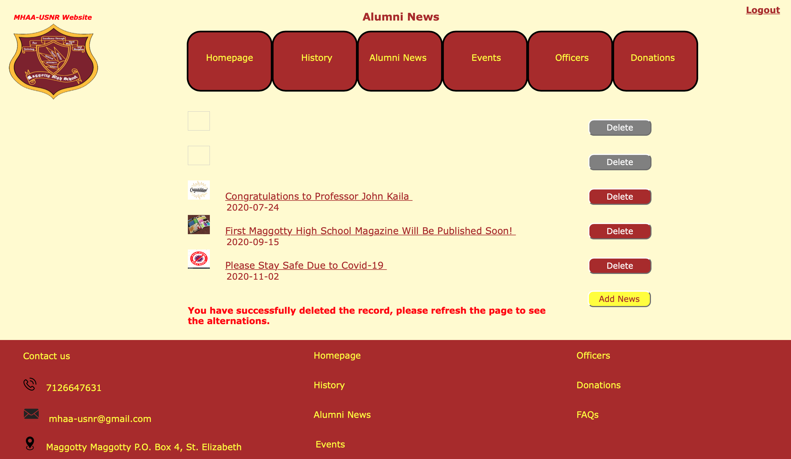
Alumni News
Officer-view
Add and Delete buttons
Logout link
User-view
Ability to Navigate the system pages
Ability to View content
Administrator-view
Add and Delete buttons
Logout link

Slide 23
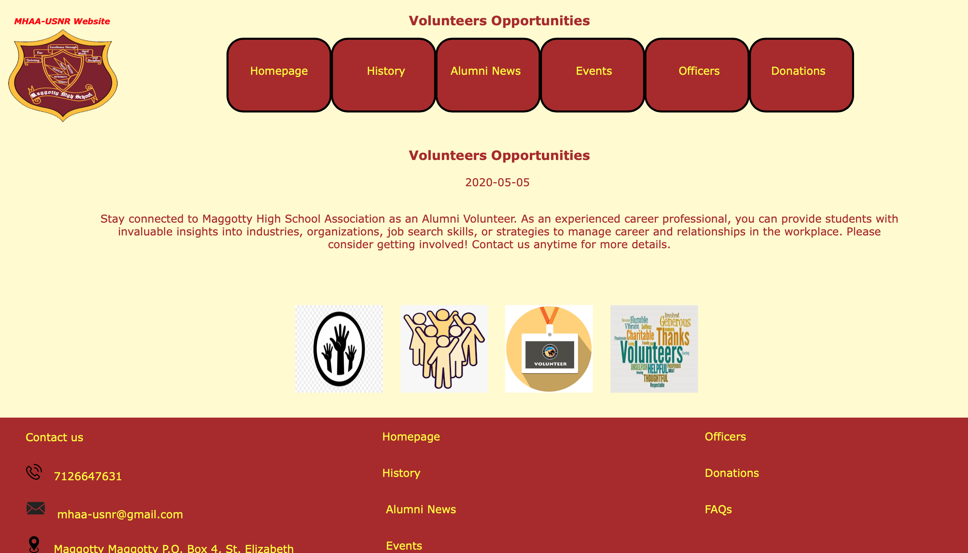
Alumni News: Viewing Record Information

Slide 24
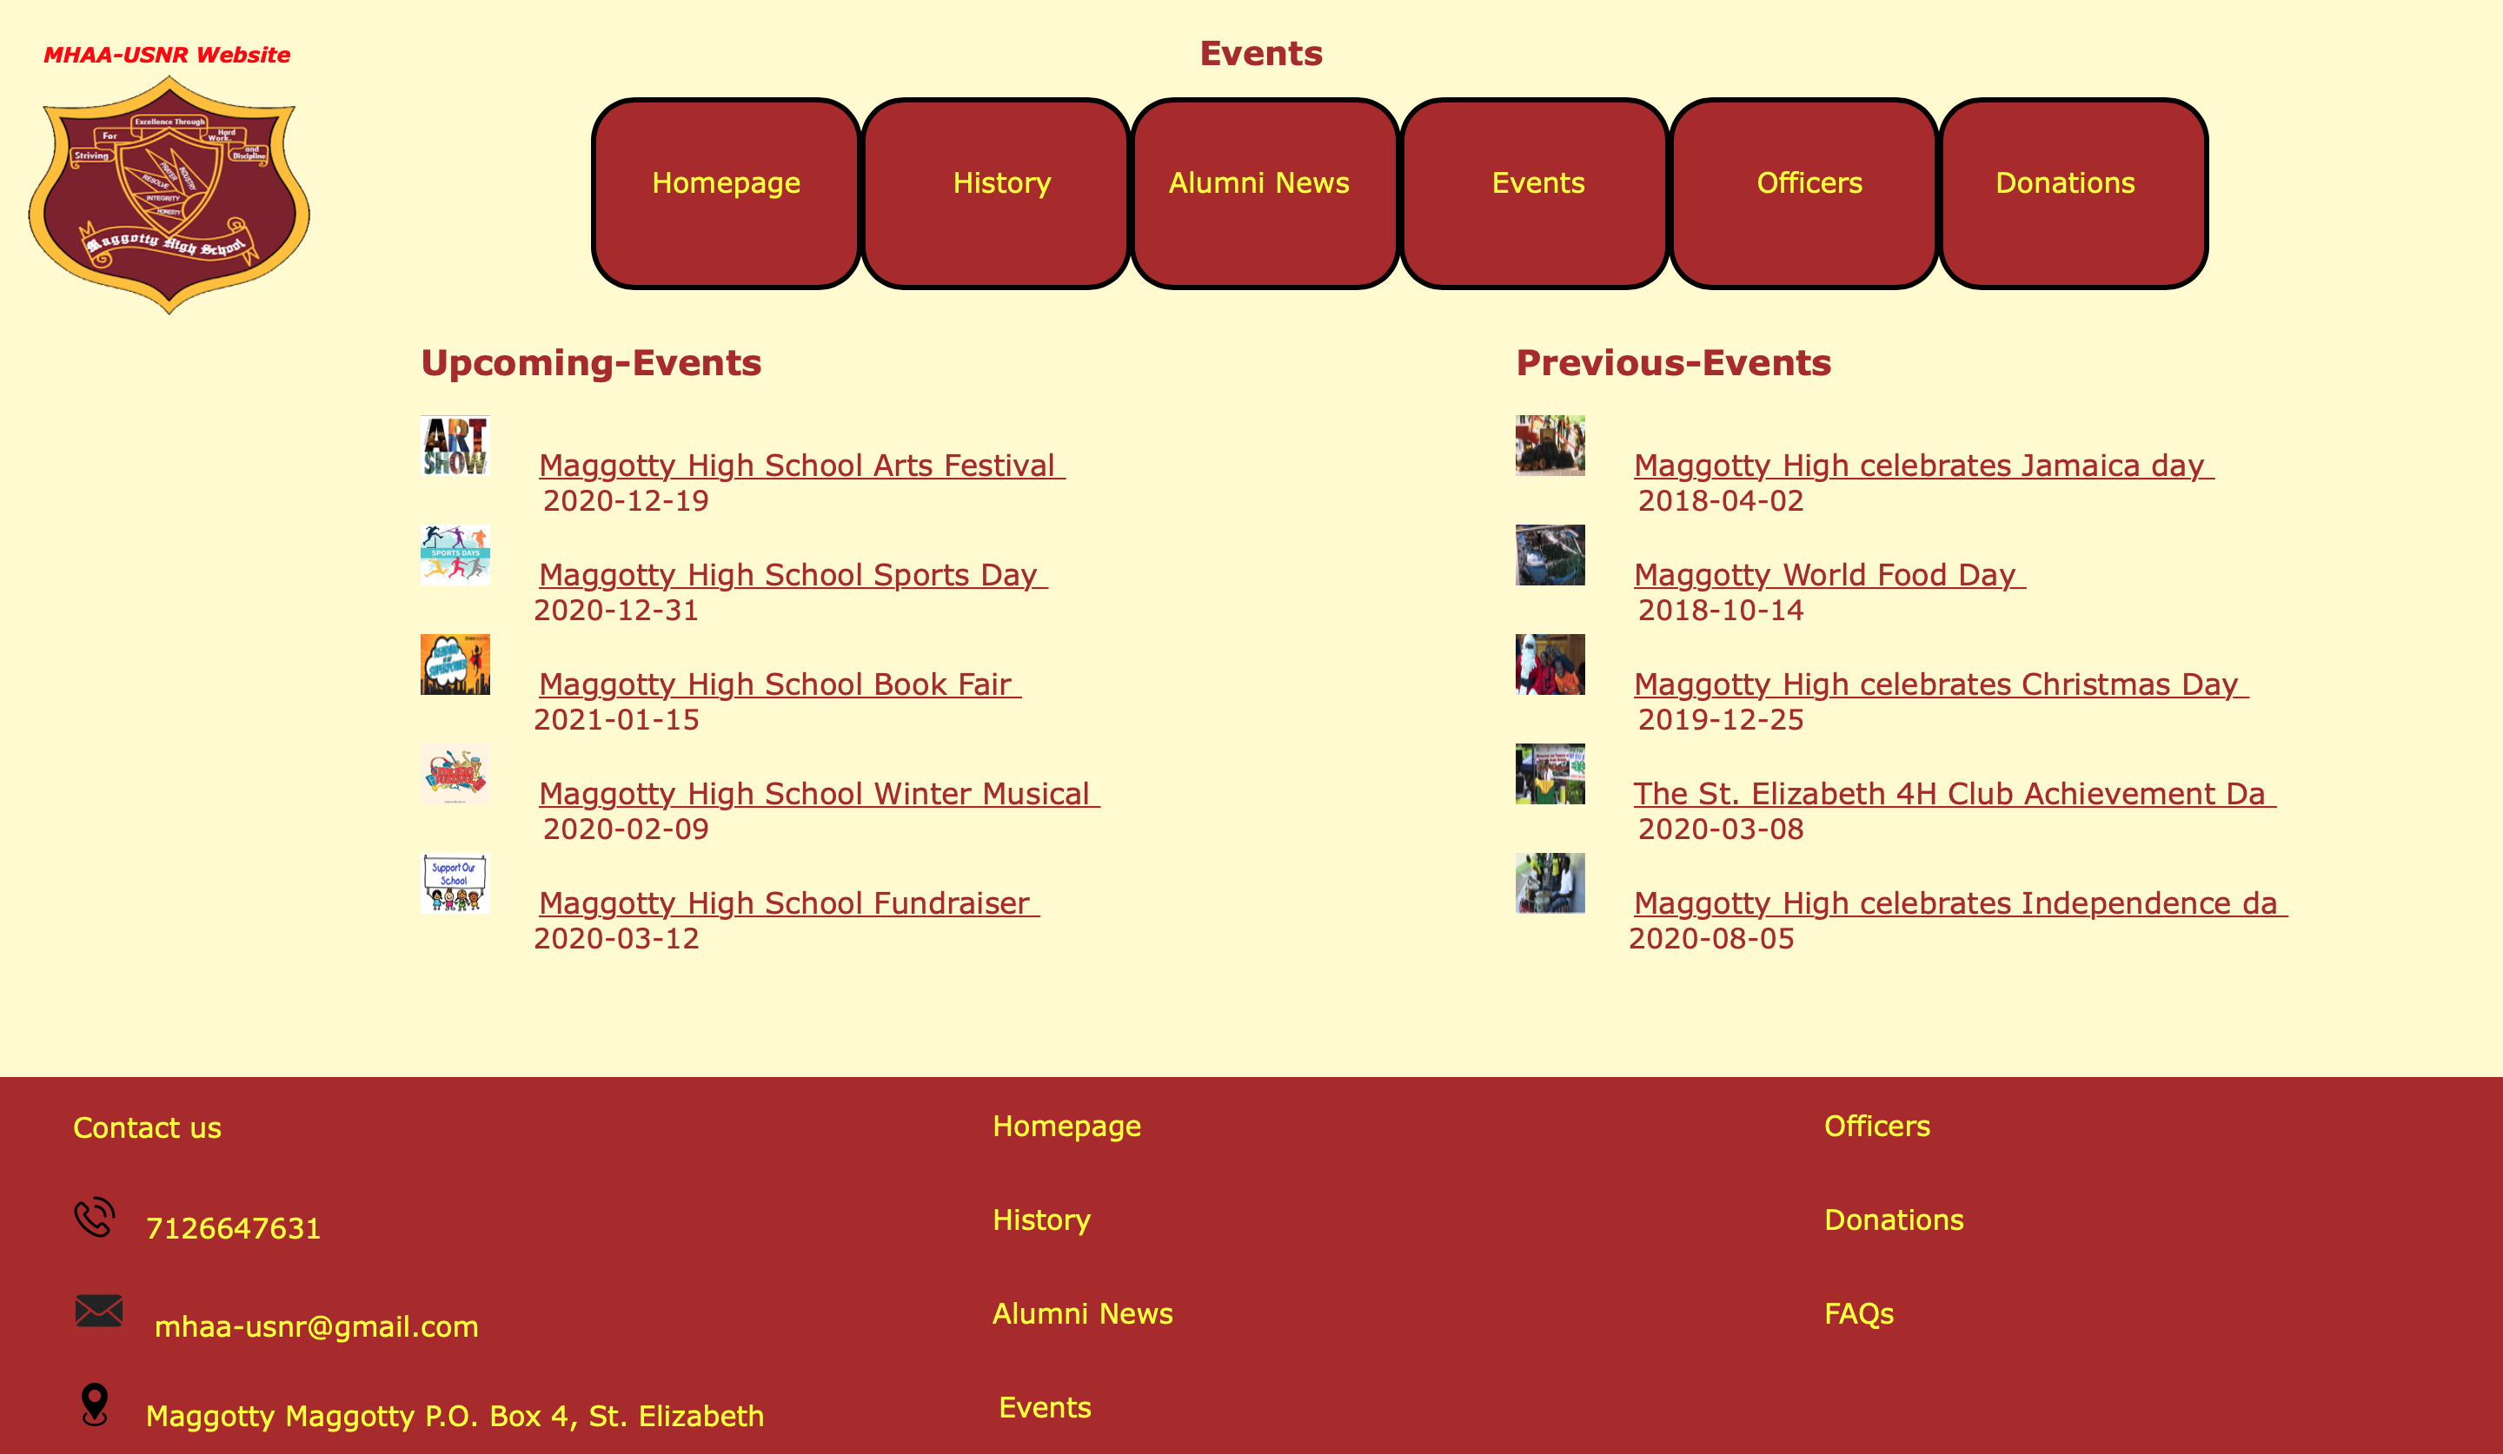
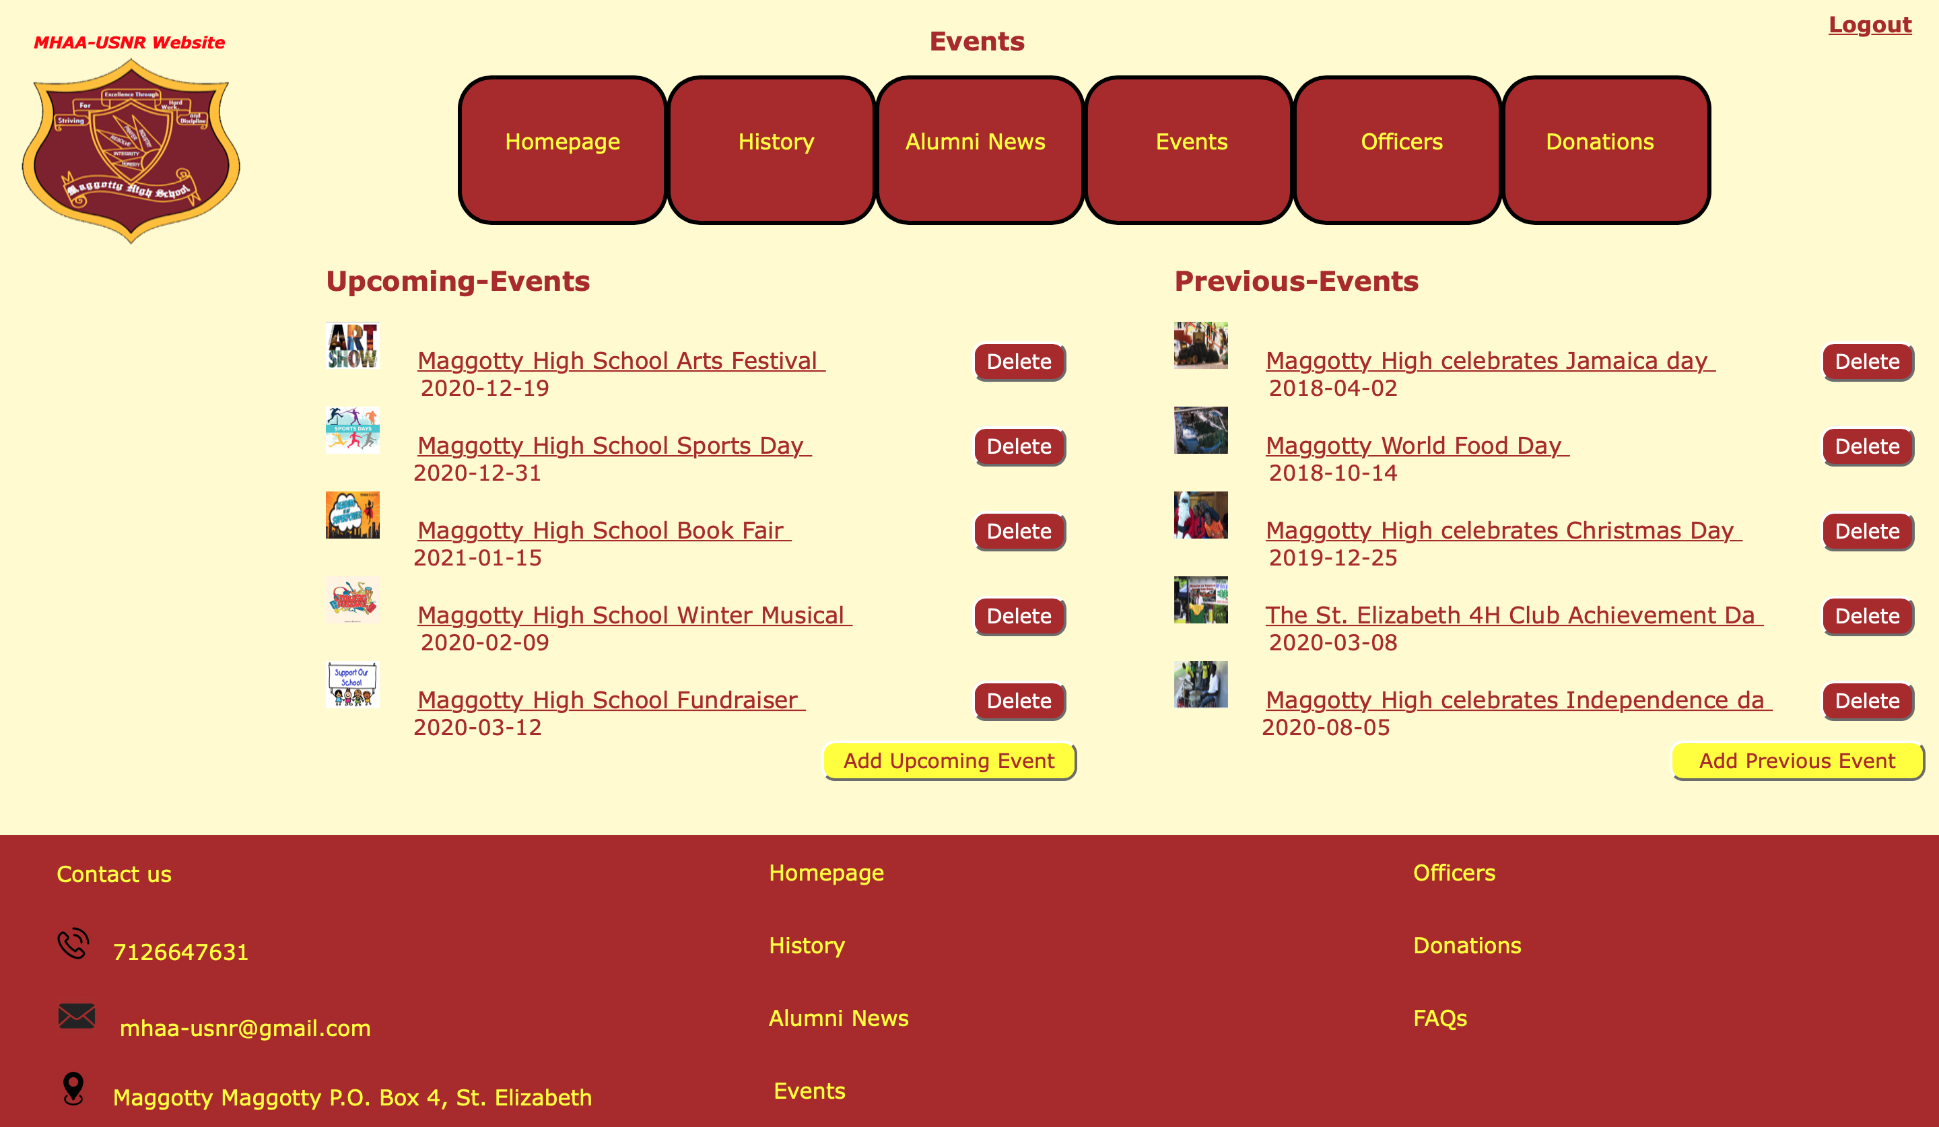
Events
Officer-view and Administrator-view
Add and Delete buttons
Logout link
User-view
Ability to Navigate the system pages
Ability to View content

Slide 25
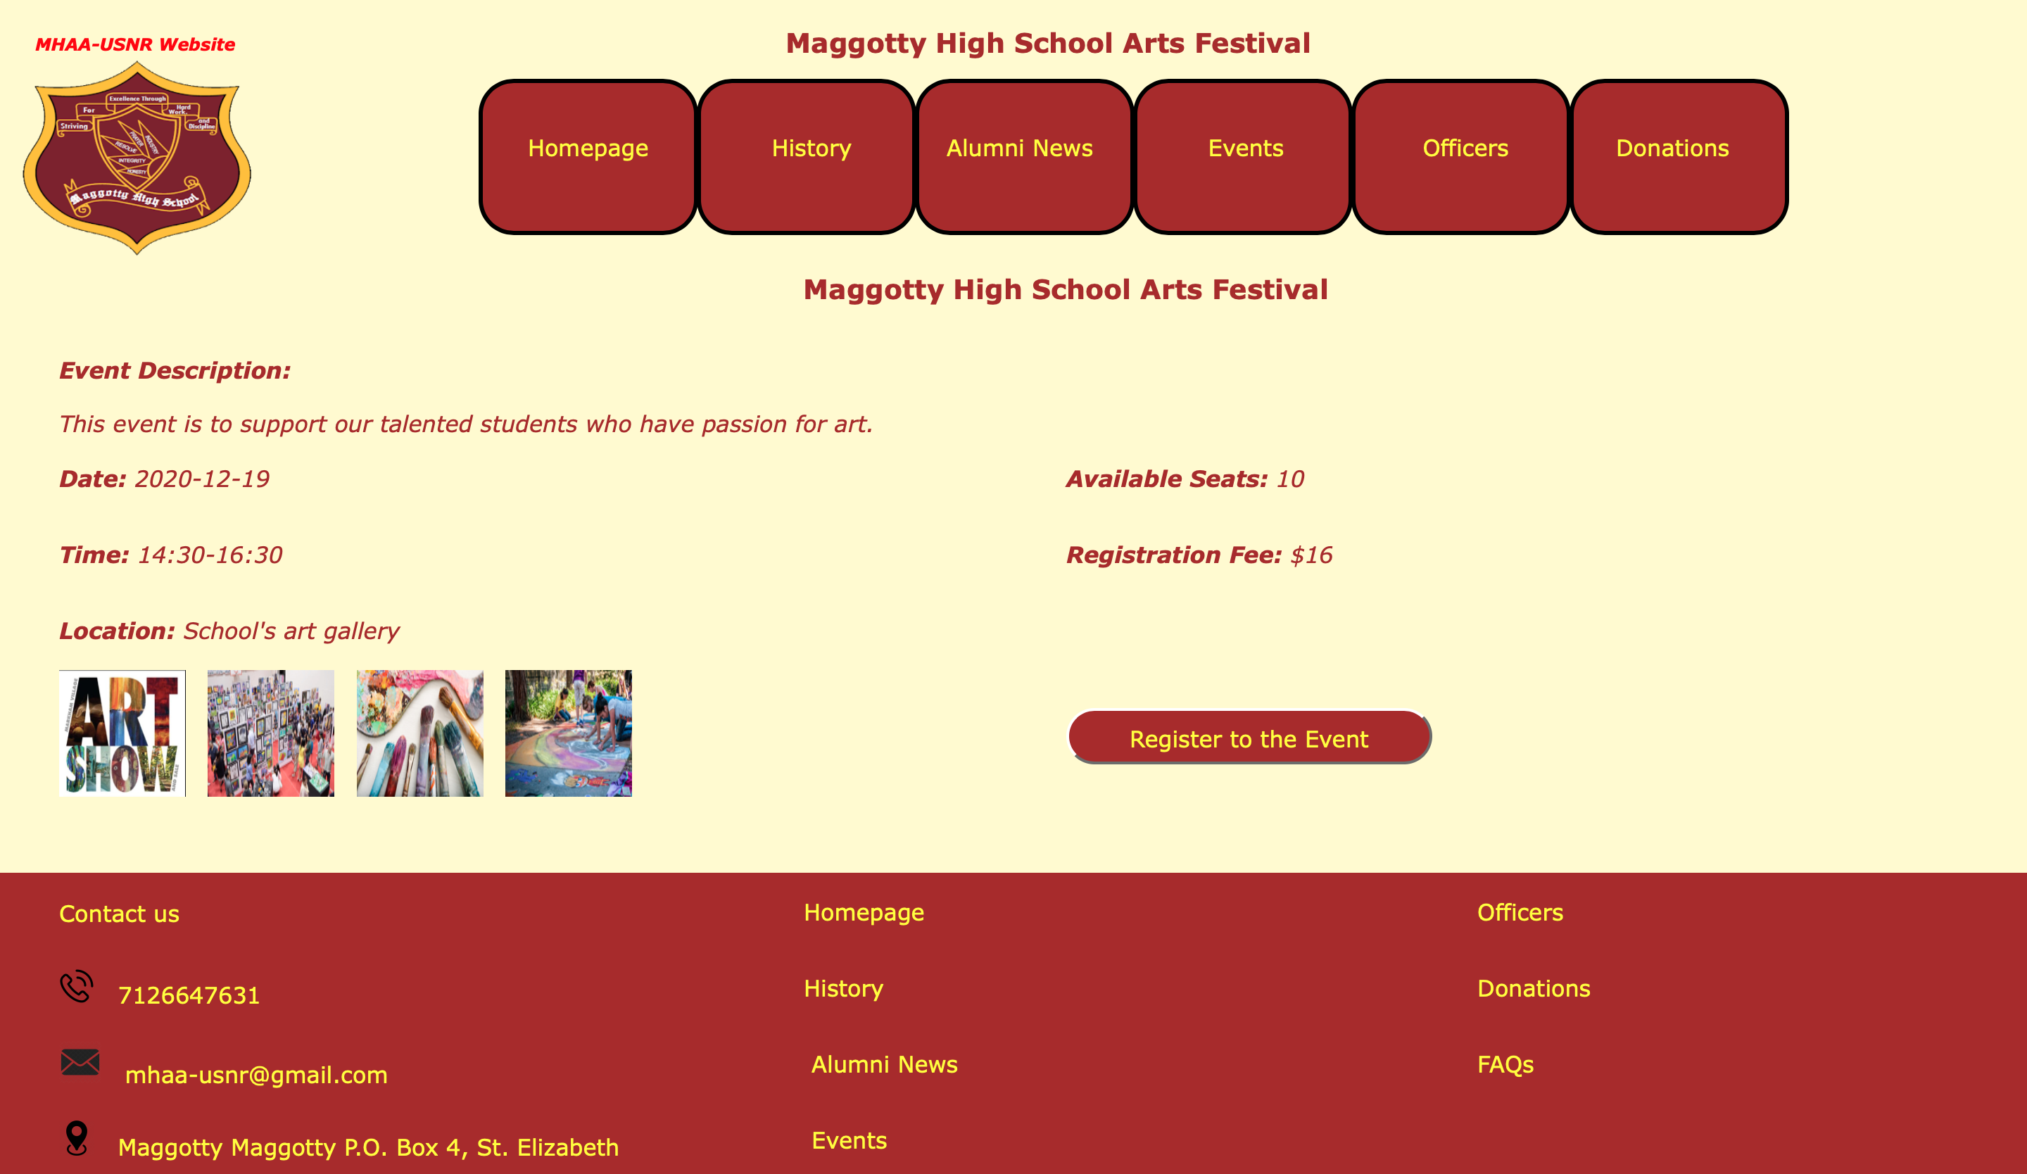
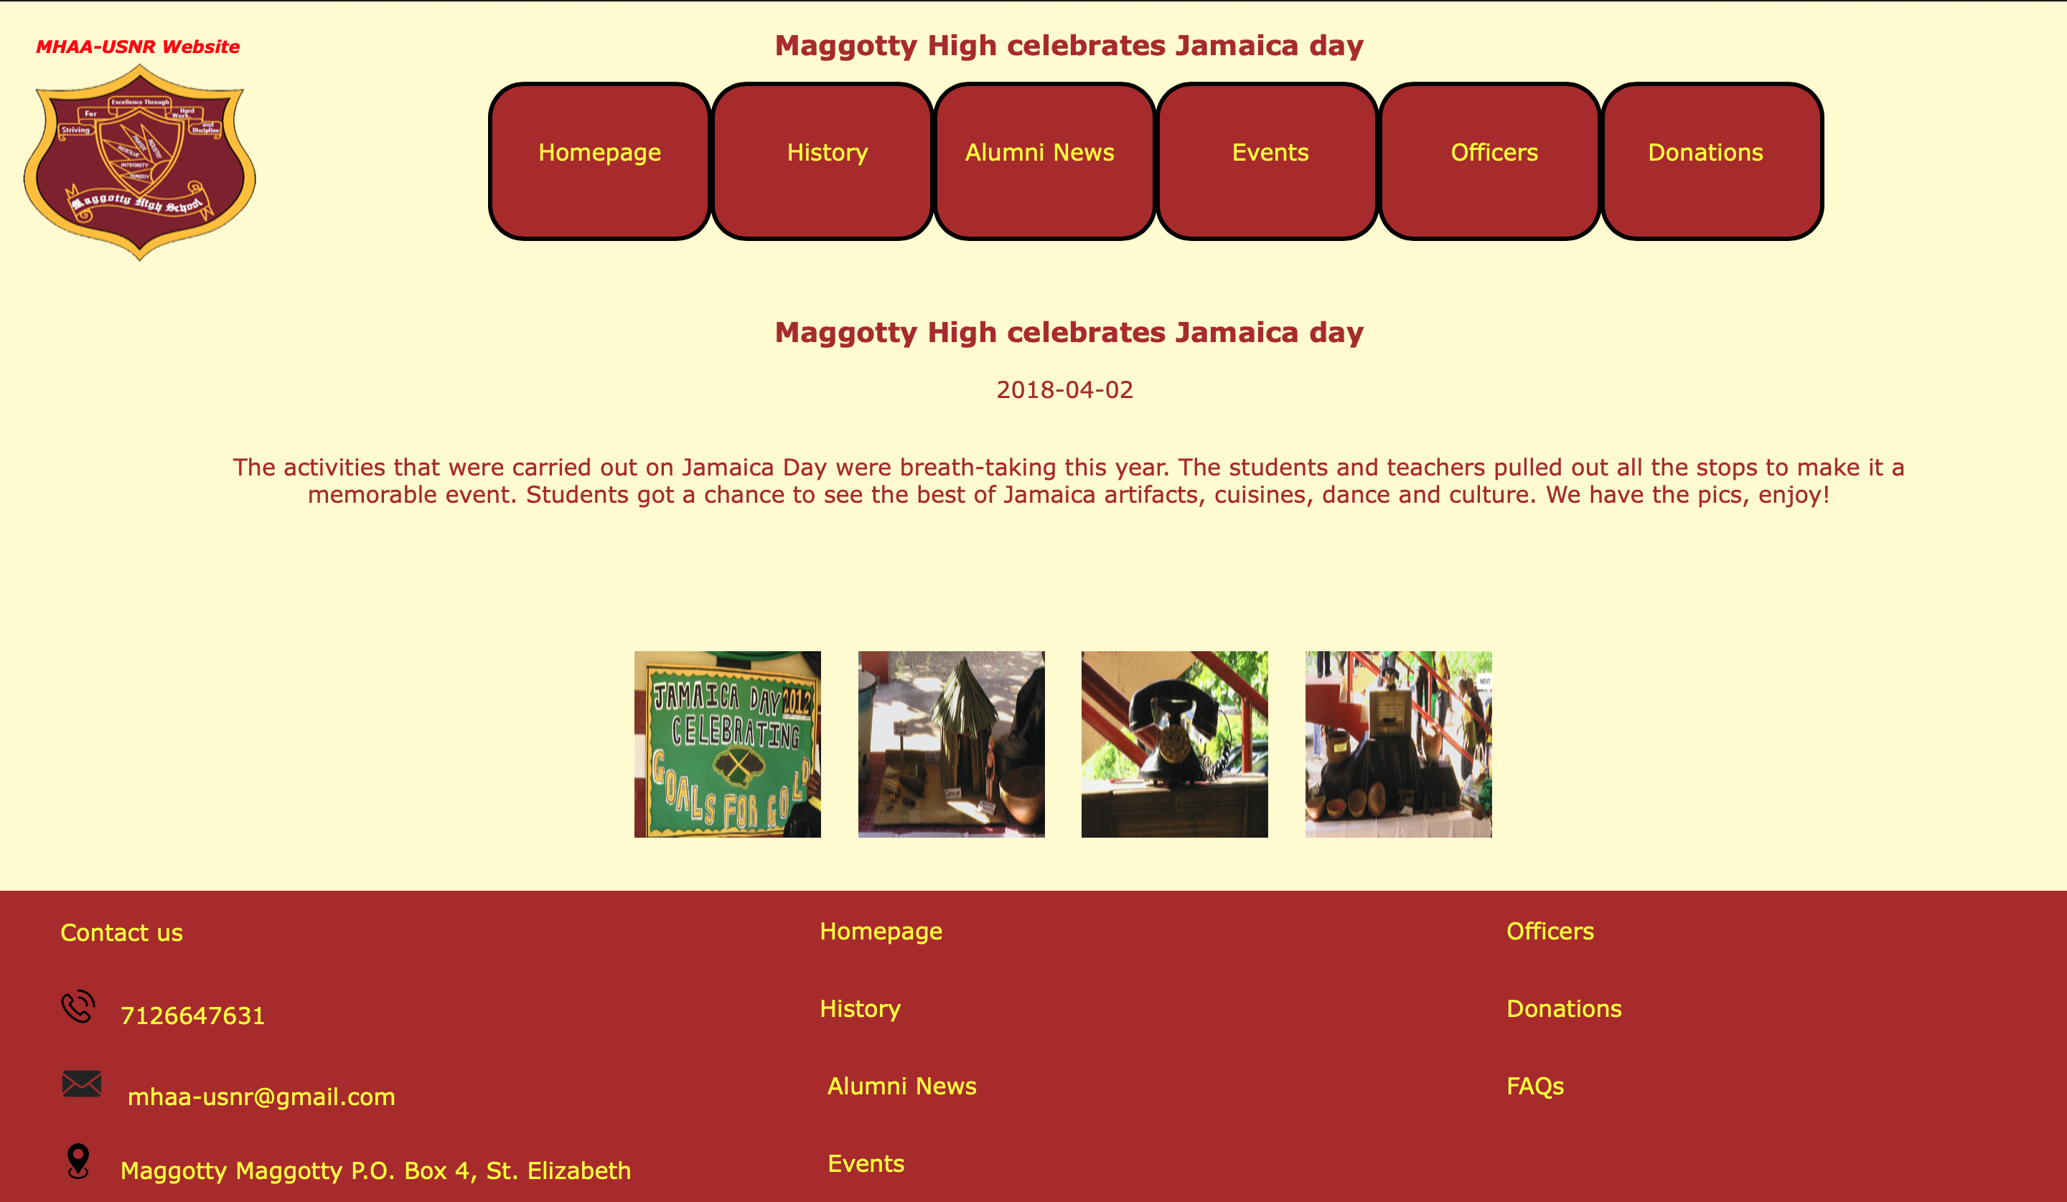
Viewing Event Record Information
Users can view event information
Register to event button
Upcoming-Events
Previous-Events

Slide 26
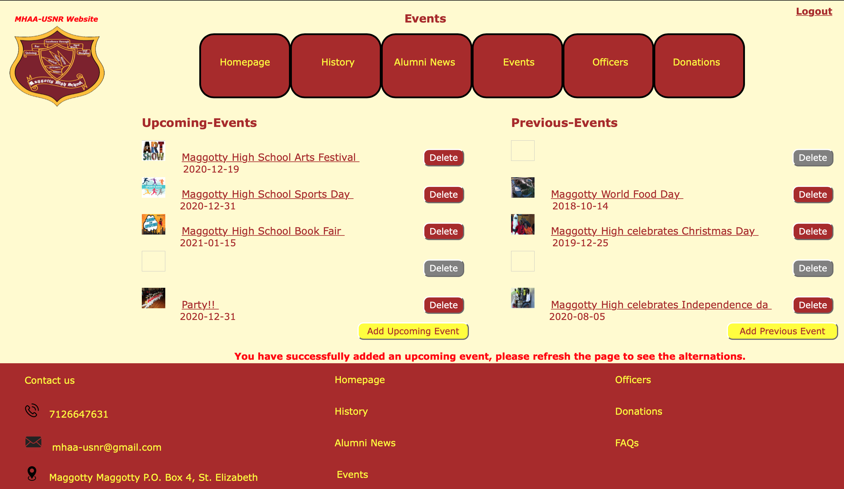
Administrator and Officers will be able to add and delete upcoming and previous events
Successful confirmation adding and deleting message
Disabled delete button

Slide 27
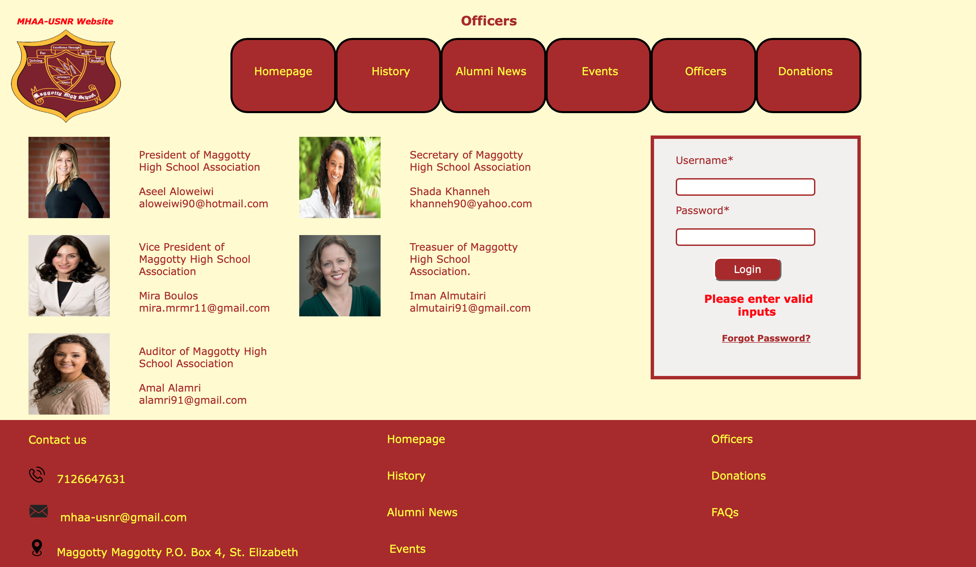

Officers
Officer-view and Administrator-view
Will be able to log into the system by entering their username and password.
User-view
Ability to Navigate the system pages
Ability to View content

Slide 28
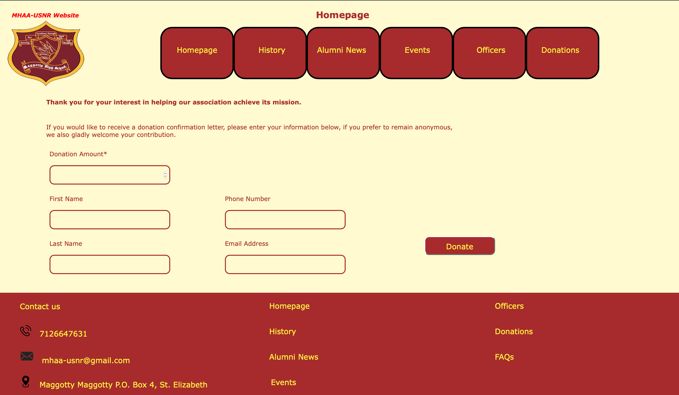
Donations
Information fields
Donate button

Slide 29
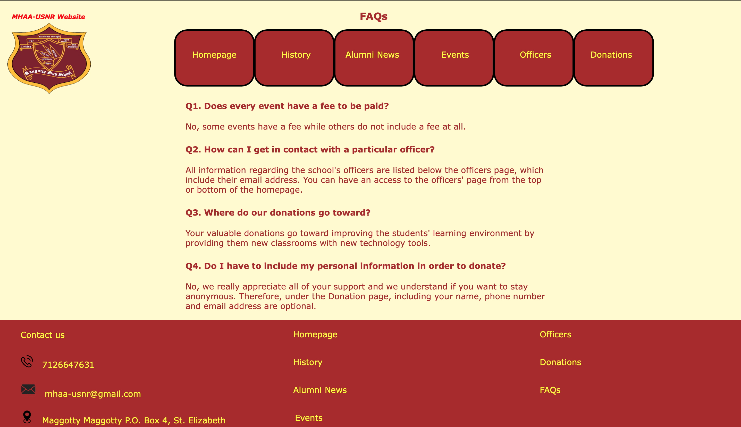
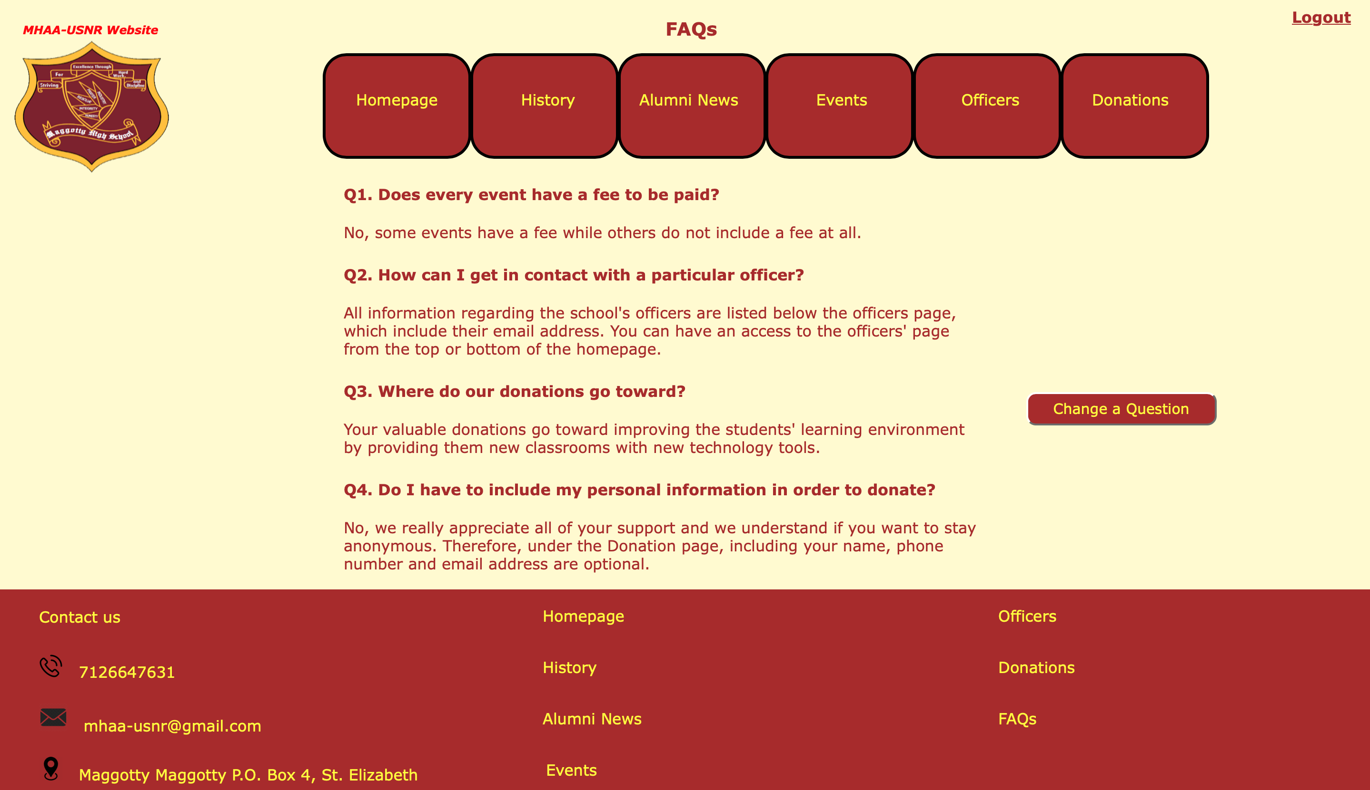
FAQs
User-view and Officers-view
Ability to Navigate the system pages
Ability to View content
Administrator-view
Change content button
Logout link

Slide 30
Testing Methodology
Testing Approach
Who Performed the Testing
Testing

Slide 31
What Testing Approach Did AntiVirus Team Use?
Black box testing
White box testing
End-to-end testing
Unit testing
Integration testing
Regression testing
Who Performed Testing?
AntiVirus Team performed the testing using test cases

Slide 32
All high and medium priority modules must be tested and fixed if there are any bugs located. Also, it must be retested after fixing the bugs by using regression testing.
System functionalities and Modules must be validated and traced back to the specified requirements listed in the SRS and Design documents.
The integration of modules must be tested to ensure that all modules collaborate appropriately, and any located bugs must be fixed.
Success
Criteria

Slide 33
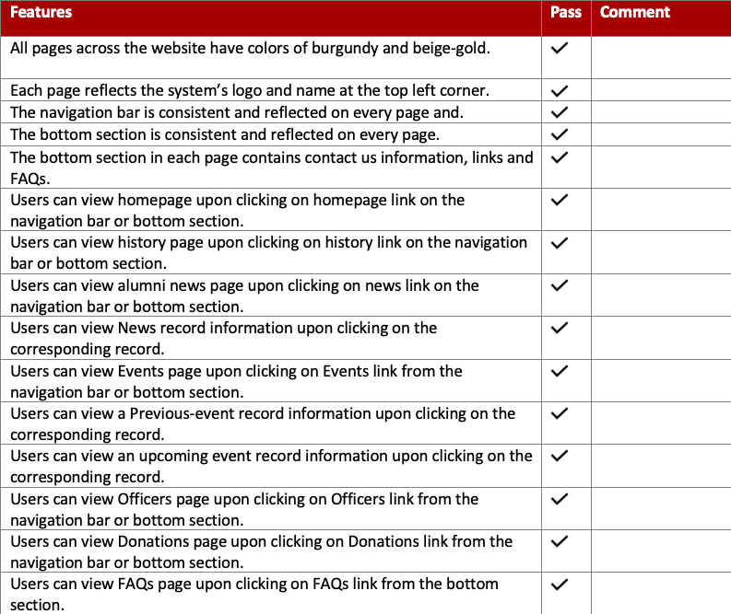

Slide 34
Tested Modules
View News
Add News Record
Delete News Record
Event Registration
View Upcoming Event Information
Add Upcoming Event
Delete Upcoming Event
View Previous Event Information
Add Previous Event
Delete Previous Event
Login and Logout
Donate
View FAQs
Administrator Privileges

Slide 35
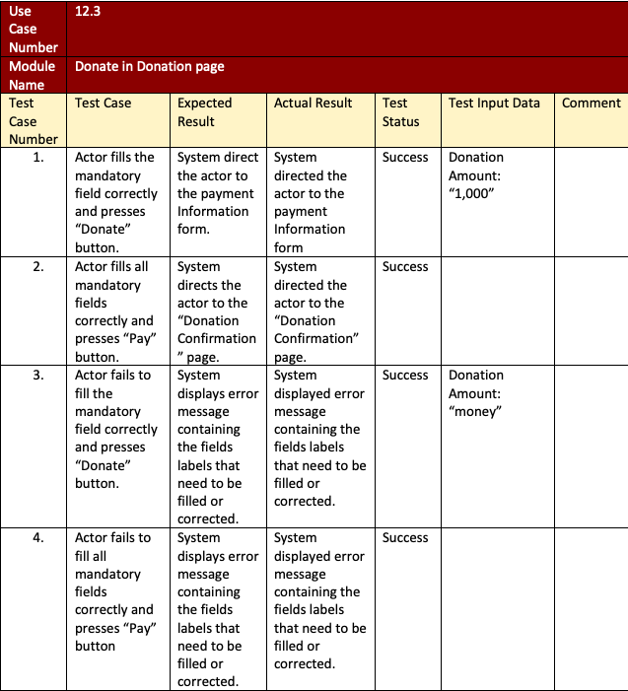
Donate Test-Case

Slide 36

User Manual

Slide 37
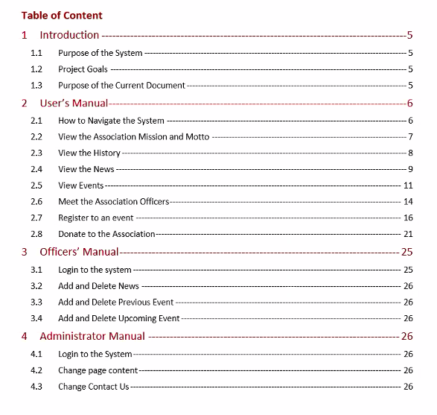
Table of Content

Slide 38
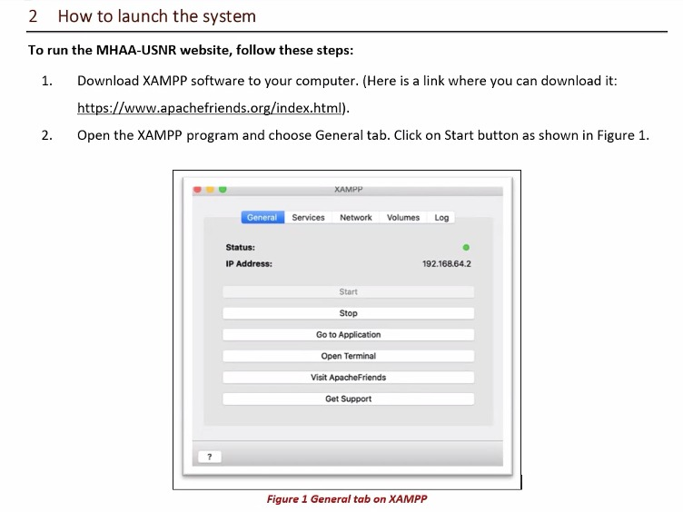
How to Launch the System
Example

Slide 39
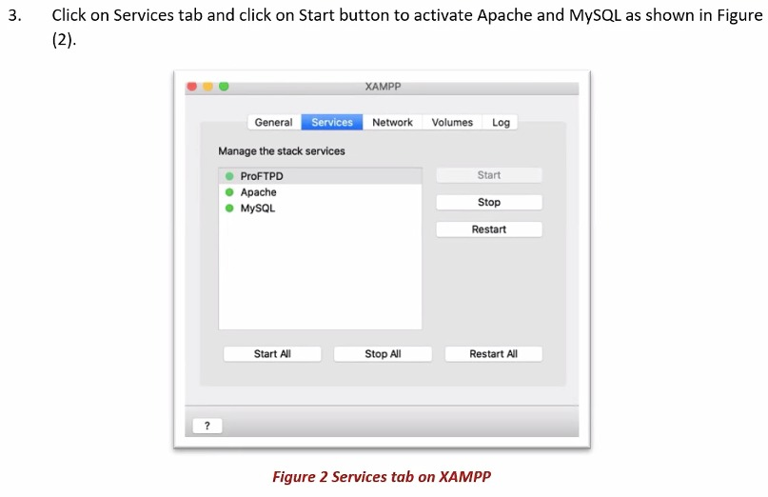
How to Launch the System
Example

Slide 40
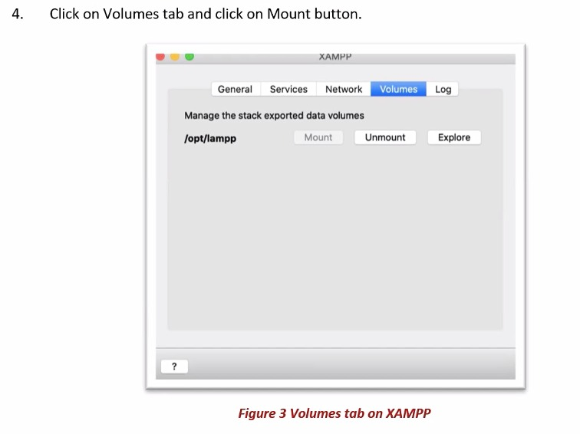
How to Launch the System Cont.
Example

Slide 41
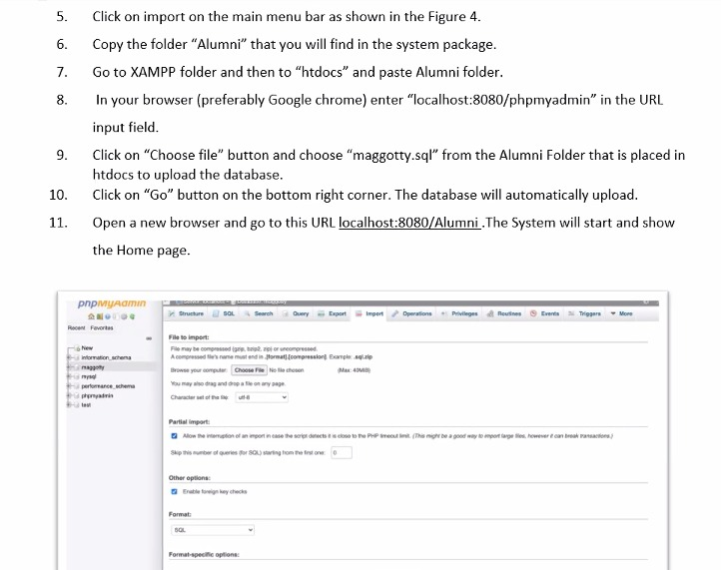
How to Launch the System Cont.
Example

Slide 42

System Deliverables
SRS Document
Design Document
Test Plan
Implementation Plan Document
Website Implementation
Source Code
User Manual

Slide 43
Thank you for choosing AntiVirus Team

